Slide 1
Six Steps to Setting up your Virtual Platform
Zoom Platform
May 31, 2020
Updated February 14, 2021
Updated March 28, 2021
Notes:
The goal of our videoconferencing is to create the feeling of sharing, participation, fellowship, and morale as much as possible short of face-to-face while sharing information, knowledge, training. Therefore, the way that we interact visually will enable our success.
Notice the word videoconferencing here is a closed compound – that is our goal; we are not separating conferencing from video. It is an integral part.

Slide 2
Why?
Notes:
We all know that “A picture is worth a thousand words.” By seeing each other simultaneously when we teach, we replicate as much as possible a classroom environment.
By seeing each other simultaneously when we meet, we are doing this for the sake of our members, not as much for the content.
We socialize. We catch up with each other. We enjoy the experience. We get to know each other from all over the flotillas, divisions, district. We bring our own experience to the table. We contribute ideas to the meeting. And we learn almost one-on-one.
The content is a by-product which is transferred as we carry out our duties.

Slide 3
Opportunity
The world is undergoing a crash course in digital.
Great opportunity for us in the Auxiliary to learn and grow
And the strength of the USCG and the Auxiliary is that in fact we operate experientially, we learn by doing, by trial and error
One of the take-aways from videoconferencing is that it is a tool which will have uses after the pandemic passes
So, why not take advantage of it now and develop it as a teaching, training, operating, communications tool?
Notes:
Feels like we are riding on a rocket ship to Mars!

Slide 4
Prerequisites
To participate, you will need a device with a working webcam and microphone
Either a desktop, laptop or tablet is preferred
While mobile phones work, they may be too small to effectively participate in these virtual classes

Slide 5
Six Steps
Notes:
These are AVERAGE estimated times to cover the six key basic steps to setting up a meeting with someone familiar with computers. Someone who is less familiar will need more time to become familiar with computers as well as with video conferencing.
This is a summary approach. Zoom is a very rich tool and more can be learned as it is employed for your meetings.
It is important to take each step deliberately and thoughtfully, applying it to the audience and the purpose of the meeting.
A training meeting will be different from a Public Education Meeting than from a division or flotilla business meeting.
Zoom is rich in tutorials, videos, live training. A good practice is to take one at a time a few days before your next meeting. That way it gives you a fresh perspective and an idea on how to play with a particular tool that you might not have used before or could use refining.

Slide 6
1. Select Plan – Pro Version is recommended for meetings, training and PE classes
Zoom Pricing
https://zoom.us/pricing
Notes:
Review and understand the plan alternatives.
Basic is free up to 40 minutes. Unlimited number of meetings. All the basic features. Great plan – only limited by the 40 minutes to be free.
Pro offers all the Basic features and increases each meeting duration to 24 hours. Has cloud recording and other optional add-on plans.
Business offers all the Pro features and increases participants, adds dedicated phone support, and other features.
Enterprise offers all Business features and increases participants, unlimited cloud storage, dedicated customer service and bundle discounts.
Initial recommendation is to consider using the features for Pro which you can begin to use gradually…Pro supports up to 9 hosts per plan and would seem to be suited for most divisions, flotillas or large MT/PE classes.

Slide 7
2. Settings – a. Personal Profile
Notes:
The second step is to set up the overall administration settings. Most of us are used to our software being administered by others. Here we have the opportunity to set up the controls for ourselves. And they can be modified for different meetings. Admin is divided into the global controls in Administration and the specific meeting controls in Personal.
Zoom actually is very simple to set up. A non-IT person can set it up. The secret is to carefully and deliberately consider each selection in the order offered.
Control F6 search function is very helpful (or Control F depending on your operating system).
For the Account Profile - Recommend current professional CGAUX photo in Trop Blues or ODU.
Be sure to select Calendar and Contact Integration. Without their functionalities, you cannot take advantage of all the great Zoom scheduling features.

Slide 8
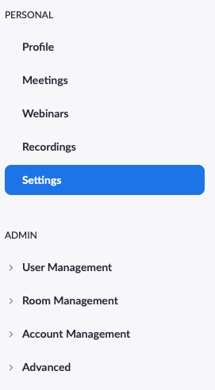
2. Settings - b. Personal Settings
Notes:
Personal settings govern your individual meetings.
Again, go through them carefully keeping in mind the purpose of the meeting.
It is good practice to review them occasionally.
They should always be reviewed after Zoom version updates in case default settings have been changed.

Slide 9
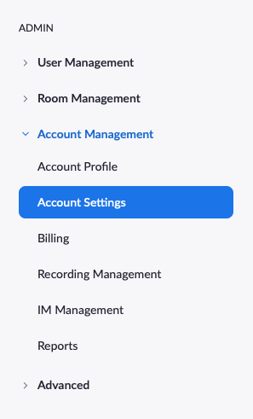
2. Settings - c. Account Settings
Notes:
Admin – account settings are your global settings. It would take us about an hour to go through an in-depth discussion of each selection.
These decisions are better done by the Administrator/Host in collaboration with the division/flotilla leadership or the MTs for their units, or the Instructor for their PE classes or HR for their recruiting.
The discussion around the selection of each option is actually very helpful in beginning to understand the multiple benefits and uses of this tool.
Account Setting > Management - It is good practice to review these prior to setting each meeting to ensure applicability of selections. Some meetings might warrant recording, others not, etc. Settings can be changed for each meeting. Use lock to keep settings from being changed accidentally.
Review these for applicability to your own meeting and circumstances and in some cases, for style or preference.
With practice, you will develop preferences based on the type of meeting.
TIPS:
Authentication process is not recommended for these small meetings with well-known participants.
Passwords and Wait Room strongly recommended to control access.
Most meetings should be open 15 to 30 minutes prior to formal start.
Encourage participants to have video and audio immediately upon joining the main room from the Waiting Room; it fosters a sense of fellowship and socialization.
Encourage audio to stay on for the whole meeting; only mute noisy audios. Otherwise encourage their use to create an atmosphere of a classroom or a business meeting where there are no mute buttons.
Encourage all to use video for the whole meeting; only close video if you step away for a moment. It is poor etiquette to participate without showing video as it messages that you are otherwise engaged or too good to participate. For privacy, use a virtual background.
Recording chats for business meetings can assist the Secretary of Records with the minutes. The recording can be erased after 90 days to allow sufficient time for review and approvals.
Practice polling in advance. Prepare a couple of polls for the first meeting to show participants the type of straw polls, questions, etc. that can be posed.
While setting up the Waiting Room, click the pencil to customize the waiting room messaging, add a logo, etc.

Slide 10
3. Schedule Meeting
Notes:
New Meetings can be created at the moment or can be scheduled in advance.
To start an instant meeting simply start a meeting and send an invite to the individual(s).
To create a scheduled meeting, simply fill in the Schedule a Meeting page.
Click on Select New Meeting
Follow prompts
Select automatic Meeting ID and Meeting Password
Require meeting password
Meetings can be easily edited if necessary.
Avoid on the hour and half-hour scheduling to minimize rush hour crunch. An odd time can be entered.
After you Save Meeting, the next screen will confirm your selections. You can edit or go on to select your preferred calendar option and proceed to fill that out.
You can create a Template for future meetings.
You can select Registration for ease of tracking invitations, notifying updates.

Slide 11
4. Send out invitations
Notes:
This is a most powerful tool: Select preferred calendar: Google, Outlook, Yahoo. Click on it.
Once on the calendar, add any specific comments and enter guest lists. Have Group lists prepared in your contacts.
The invitee will receive a Google/Yahoo/Outlook calendar appointment and should click respond to the invitation. Yes/No/Maybe.
That will record their answer and facilitate any reminders/follow-ups.
You will also have a copy of invitees readily available for your meeting.
Use the invitation to reinforce key messaging as well as mechanical aspects.
It does not matter if the recipient does not have or use a calendar; they will still receive the invitation with the information. They can accept the calendar invite or simply note the meeting particulars in their own way.
Each time you use the calendar invite you say to your guest: I care enough to go the extra mile to make this easier for you.

Slide 12
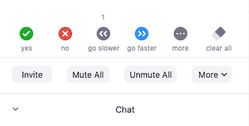
5. Familiarize/Practice Controls
Screen: Full, Gallery, Speaker
Notes:
Time to Play… click and explore each on on your own time and each time you are in a session and have the opportunity to do so
Set up a test meeting with Co-Host for the first time.
Set up someone else as a Co-Host at the start; this comes in very handy if the Host loses electricity or internet connection as everyone else remains connected. The Co-Host can continue the meeting.
Practice controls.
Do a full dry run.
Bring out main controls from bottom or top of screen by hovering the mouse.
Hover the mouse over each symbol to see drop down/drop up menus; click and explore how each one works.
***Access to controls depends upon number of participants and to whom rights have been given*** Zoom is unusually flexible in that it allows simultaneous access.

Slide 13
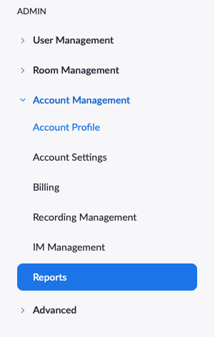
6. Create Reports
Notes:
More choices…CSV delimited for excel spreadsheets…

Slide 14
Additional Create Reports
Notes:
Explore the reports that it can give you…use for attendance, minutes, legal acceptance of recording…
These can be used as records as well as submission to your FSO-IS

Slide 15
APPENDIX
2. Suggested Personal Settings
3. Suggested Account Settings
6. Additional Create Reports
CGAUX Training
Zoom Self-Study
Thank you!

Slide 16
2. Suggested Personal Settings
Personal Settings that I use:
Start with defaults
Telephone and Computer Audio
Require Password
Embed Password
Require encryption
Chat – prevent participants from saving chat
Feedback and Survey
Co-host & Polling
Show control bar
Show Zoom windows during screen share
Screen sharing
Annotation & Whiteboard
Notes:
Personal settings govern your individual meeting.

Slide 17
2. Suggested Personal Settings
Continued Personal Settings
Non-verbal feedback
Report to Zoom
Breakout room
Virtual background
Identify guest participants
Waiting room
Join from browser link
Email notifications – all
Notes:
Personal settings govern your individual meeting.

Slide 18
2. Suggested Account Settings
Admin Settings that I use:
Start with defaults
Require a password
Embed password for one-click
Calendar and Contact Integration
Chat
Feedback and Survey
Co-host
Polling
Screen sharing
Annotation & Whiteboard
Remote control
Non-verbal feedback
Rename
Report to Zoom
Notes:
It would take us about an hour to go through an in-depth discussion of each selection.
These decisions are better done by the Administrator/Host in collaboration with the division/flotilla leadership or the MTs for their units, or the Instructor for their PE classes or HR for their recruiting.
The discussion around the selection of each option is actually very helpful in beginning to understand the multiple benefits and uses of this tool.
Account Setting > Management - It is good practice to review these prior to setting each meeting to ensure applicability of selections. Some meetings might warrant recording, others not, etc. Settings can be changed for each meeting. Use lock to keep settings from being changed accidentally.
Review these for applicability to your own meeting and circumstances and in some cases, for style or preference.
With practice, you will develop preferences based on the type of meeting.
Authentication process is not recommended for these small meetings with well-known participants.
Passwords and Wait Room strongly recommended to control access.
Most meetings should be open 15 to 30 minutes prior to formal start.
Allowing participants to have video and audio immediately upon joining the main room from the Waiting Room fosters a sense of fellowship and socialization.
Recording chats for business meetings can assist the Secretary of Records with the minutes. The recording can be erased after 90 days to allow sufficient time for review and approvals.
Practice polling in advance. Prepare a couple of polls for the first meeting to show participants the type of straw polls, questions, etc. that can be posed.
While setting up the Waiting Room, click the pencil to customize the waiting room messaging, add a logo, etc.

Slide 19
2. Suggested Account Settings
Continued Admin Settings:
Breakout Room
Virtual background
Identify Guest participants
Waiting Room
Email notifications - all
Admin option use default content delivery network (CDN)
Allow users to contact Zoom’s support via Chat

Slide 20
CGAUX Virtual PE Classes Training
To schedule individual training classes, group training
Resource for questions, practice, trouble-shooting
Hortensia Sampedro, DVC-Electronic Media (305) 742-8221
To receive updates on training and resources, sign up to receive the E-Directorate Blog at: cgauxboatingclasses.org
Feedback and observations welcome
Notes:
Please let me know if there are any aspects of this training about which you would like to learn more.

Slide 21
Zoom Self-study
Zoom Help Center
Video Tutorials
Attend Live Training
Notes:
This has been a high-level summary to help to get you started. Keep taking classes.
Rich variety of knowledge, tools, tips, etc.
Suggest accessing them regularly
Subscribe to their blog
Look up specific subject matters to get answers
Attend as many live meetings as you can
Play with the controls one at a time to see each one’s operation. This builds mental memory and is a good practice.
Select other videos periodically; review them frequently. They are rich with information not easily captured or remembered the first time.
Also, as you use Zoom, you build up your own body of knowledge for your own specific purpose.

Slide 22
Thank You
If any questions, contact Hortensia Sampedro, DVC-Electronic Media (305) 742-8221
To receive updates on training and resources, sign up to receive the E-Directorate Blog at: cgauxboatingclasses.org
You may email the E-Directorate at
pe.feedback@cgauxnet.us
Notes:
It’s the policy of the CG Auxiliary that we solve issues at the lowest level. If the problem, question or issue cannot be handled at this lower lever, follow the Chain and press the issue higher.
All issues should be solved at the lowest possible level and elevated as needed through the chain of leadership and management to have the issue addressed. It is NOT appropriate to go outside our organization for answers to education related issues unless specifically instructed by staff of the Education Directorate. Inquiries posed outside our organization confuse our partners and delay a proper response.
The entire staff of the E Directorate is standing by to answer any education questions that cannot be answered at a lower level.
The E-Directorate also maintains a feedback email address to assist members with answers they could not find anywhere else within the Auxiliary.
It is very important that members understand that they are not to contact the Chief Director’s office or anyone outside of the CG Auxiliary Chain of Leadership and Management. Any requests outside the Chain unnecessarily tie up resources answering these questions at BSX, NASBLA, and the BLA offices for internal Auxiliary queries. At the very least, it paints the Auxiliary as undisciplined and unable to communicate internally. At worst, it threatens our credibility at a national level with these national partners which can have important ramifications on future relationships.

